Slide 1
Week 6
Query By Example (QBE)

Slide 2
Student Objectives
Upon completion of this video, you should be able to:
Use Query By Example to create a query in MS Access without writing SQL
Use Query By Example to create a query the computes an aggregate function
Use Query By Example to create a unmatched query

Slide 3
Query By Example (QBE)
User friendly language developed by IBM
Based on the domain calculus
To use it you fill in templates of your tables with the restrictions you are after
Giving examples of what you want
The user doesn’t have to know SQL, just fills in templates of tables on the screen
MS Access built upon IBM's success to use visual representation of queries.

Slide 4
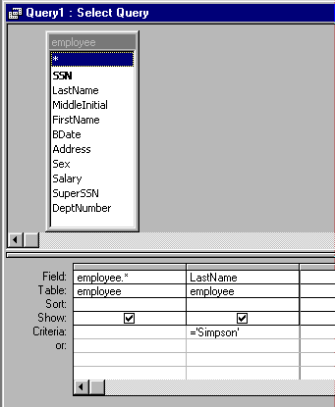
Visual Tools for Query By Example Using Microsoft Access
QBE in MS Access:
Example: One table only with a projection and a selection:
The query is: Find all the data about all employees whose last name is Simpson.
Projection
Selection

Slide 5
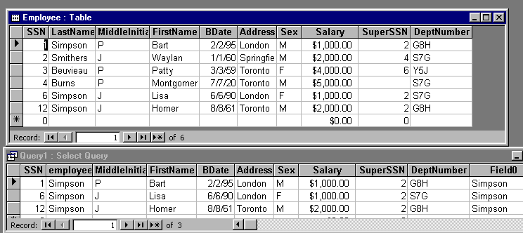

Original Table and the Query Results:
SQL generated by MS Access for QBE above

Slide 6
Let’s try it out in MS Access

Slide 7
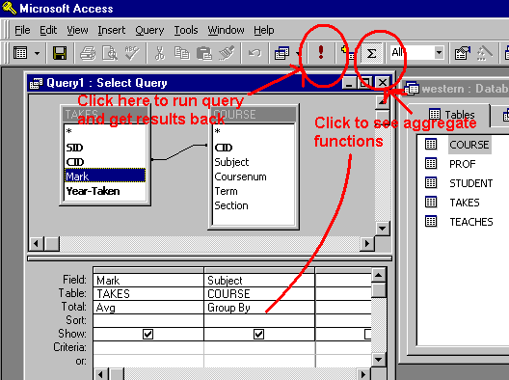
Aggregate Functions:
To do things like totals, averages, maximums, etc…

Slide 8
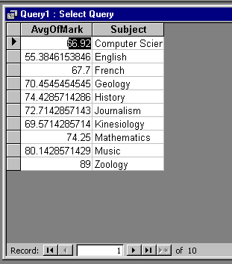

Results from Query:
SQL Generated by the Query:

Slide 9
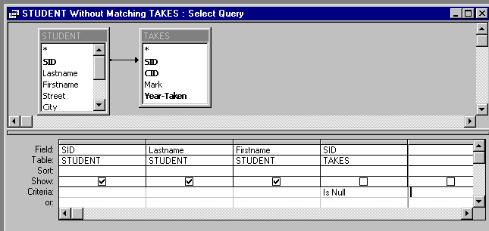
Unmatched Query
Query: Find the students who don’t take any courses

Slide 10
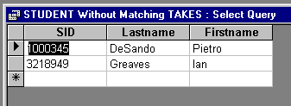
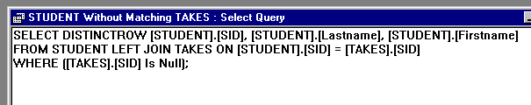
Results from Query:
SQL Generated by the Query:

Slide 11
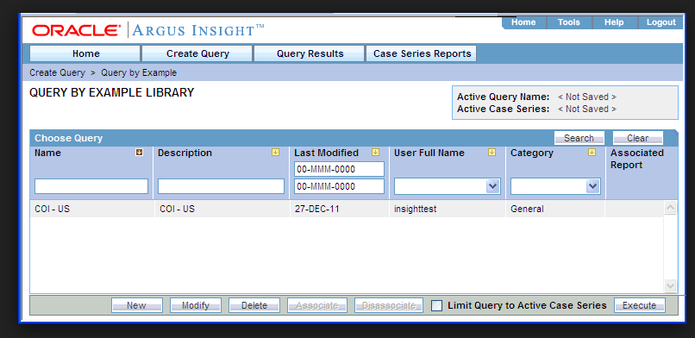
Oracle: Query by Example

Slide 12
REMEMBER:
In Relational Calculus shows you what is to be retrieved but not HOW to retrieve it
Query by Example – you don’t have to learn SQL, you can just pick the tables and then fill in columns

